Slide 1
Book Cover Judger
ML Guild Apprentice Capstone – Grant Tesdahl
September 24, 2020

Slide 2
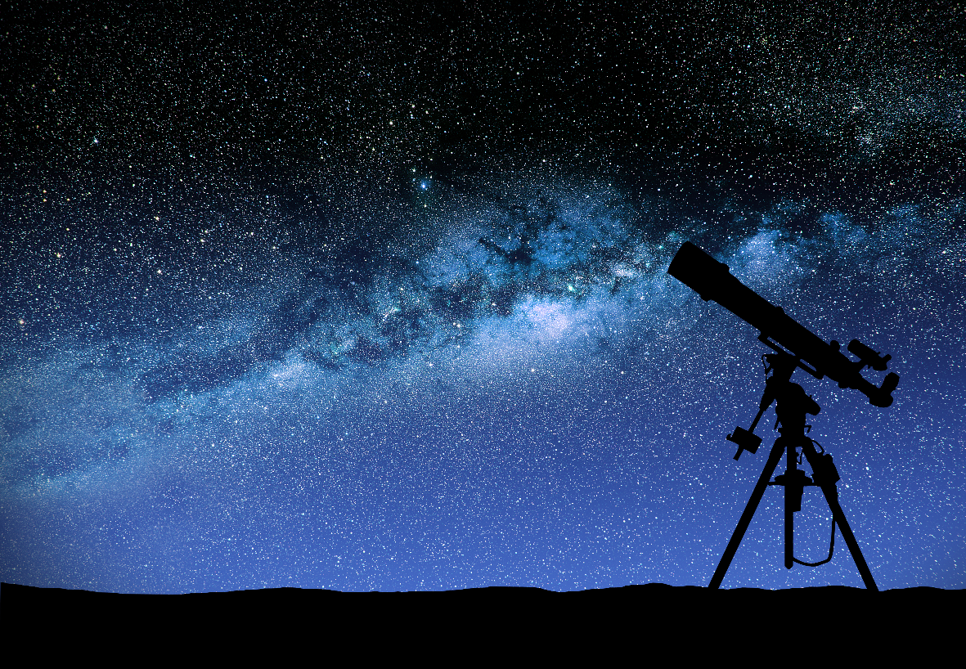
Contents
1
About Me
2
Problem Statement
3
Methodology
4
Lessons Learned & Next Steps

Slide 3

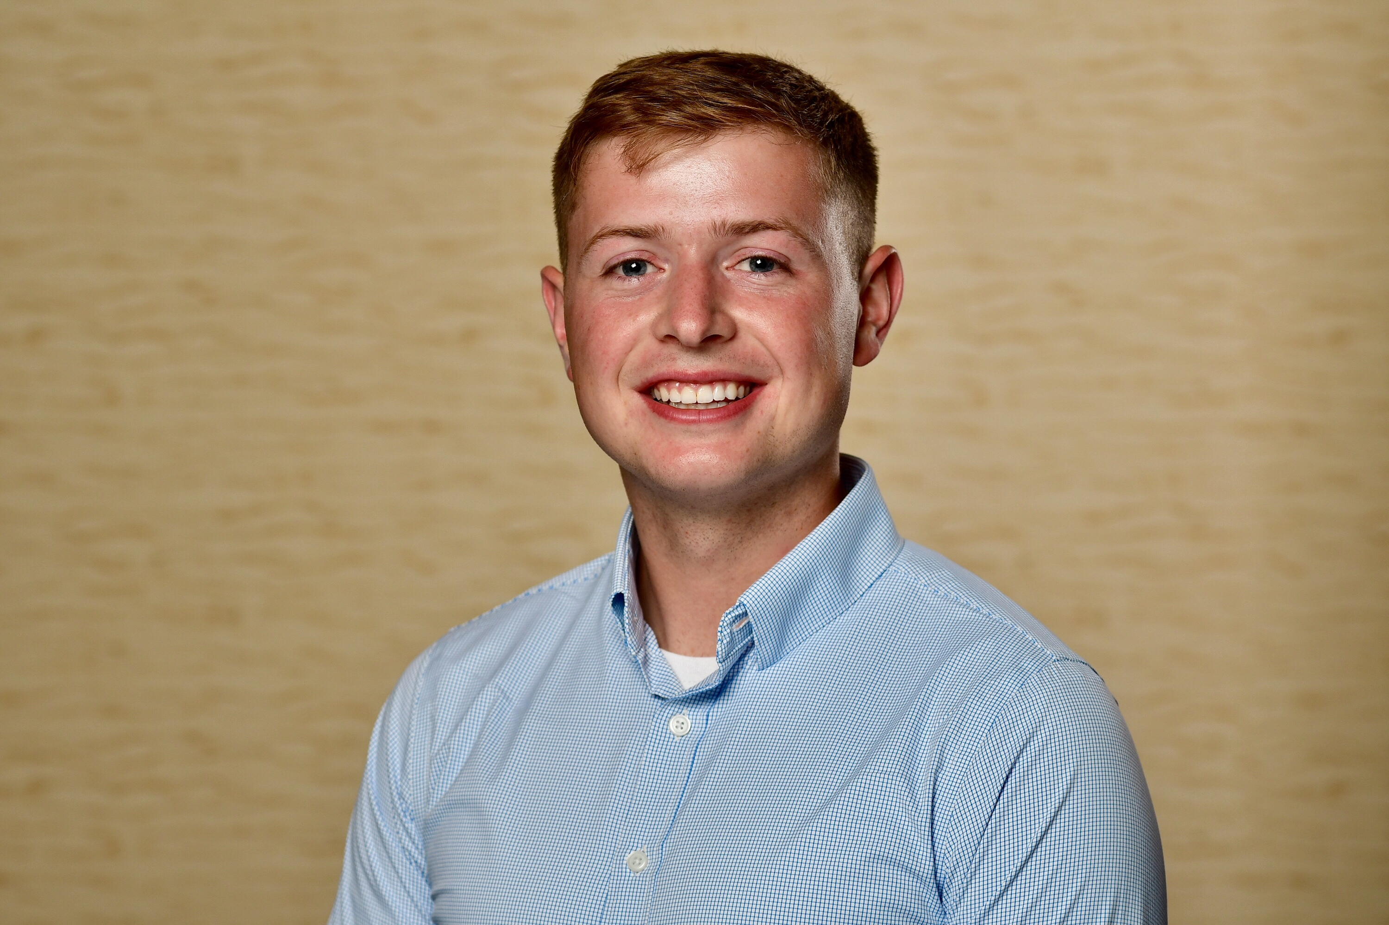


About Me
Education
B.S. in Industrial Engineering from the University of Wisconsin-Madison
Project Experience
Data Modernization at Wells Fargo (rolling off next Friday!)
Interests
Grant Tesdahl
Analyst – CBO CCG
Minneapolis
Reading, skiing, bouldering, soccer, & Freakonomics podcast
ML Journey
Before Deloitte:
Data Rich Internships at UW Health & ExxonMobil…
…but without the tools to uncover the best insights
Data Mining & Machine Learning Course…
…where I realized that ML enables those insights
At Deloitte:
Building business cases for predictive models
Banking Profitability Insights & Diabetes Mobile App
ML Guild Apprentice Program
Training + Capstone
Building predictive models
Cognitive Guided Tour: Revenue Cycle Modeling

Slide 4
Problem Statement
People Judge Books By Their Covers.
In fact, Publishers Weekly found that 75% of booksellers feel that the cover’s design is the most important element in book promotion
How can publishers ensure a given cover will maximize a book’s popularity?

Slide 5
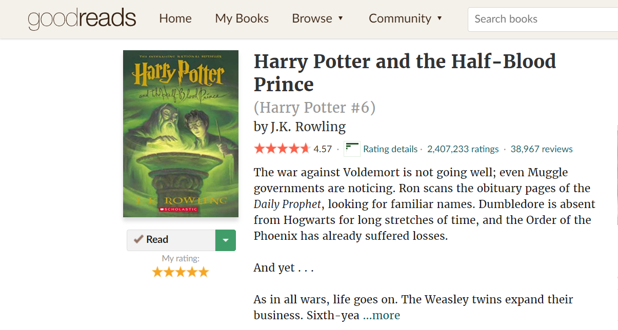
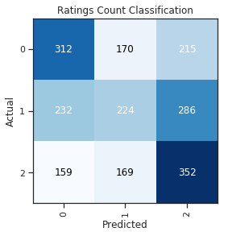

Methodology
Using book rating data and book cover images from Goodreads, I built a
CNN that predicts book popularity
DATA
Pull book review data & book cover images
Calculate potential target values related to a book’s average rating and rating count
Train a CNN for each potential target value
Compare models and pick the best target variable
Run additional training
MODELING
DEPLOYMENT
Design and code an interactive website
Integrate the model into the website

Slide 6



Data: Acquisition
Two types of data required for this computer vision task:
Book Cover Images + Book Rating Data
Approach
Captured 10k of each via Goodreads, which assigns a bookID to each book
Book Rating Data: Average Rating (indicates quality) & Rating Count (indicates popularity)
bookID = 1
https://www.goodreads.com/book/show/1
Example

Slide 7
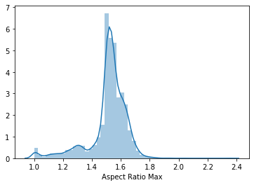
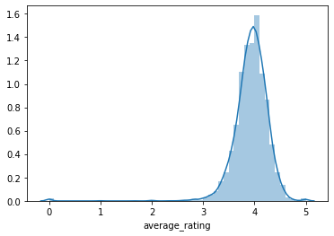
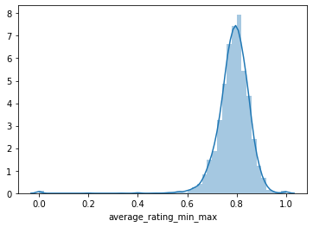
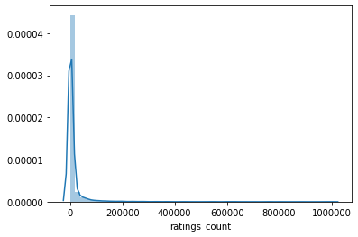
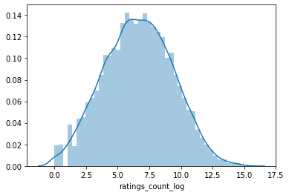
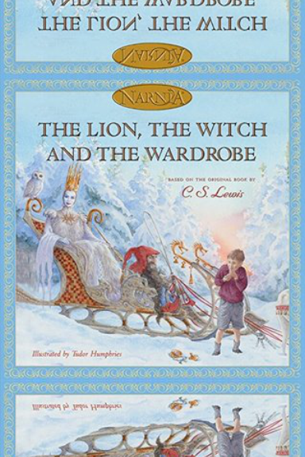
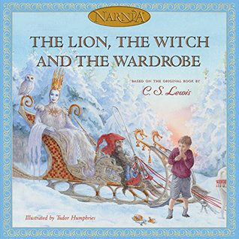
Data: Transformation
Book Cover Images
Book Rating Data
Transformed images due to unequal aspect ratios
Transformed data to create 6 potential targets (4 regression, 2 classification)
Image Aspect Ratio
Average Rating
Min-Max Norm of Rating
Rating Count
Log of Rating Count
Set aspect ratio to 1.5; Padded images with a reflection; Normalized pixel values
Original Image (Ratio = 1)
Transformed Image (Ratio = 1.5)
Classification Segment Ranges
Segment | Average Rating
High | 4.07 to 5.00
Medium | 3.84 to 4.07
Low | 0.00 to 3.84
Segment | Rating Count
High | 2,627 to 4,597,666
Medium | 223 to 2,627
Low | 0 to 223
Notes:
Look at accuracy for different aspect ratios; Why reflection?

Slide 8
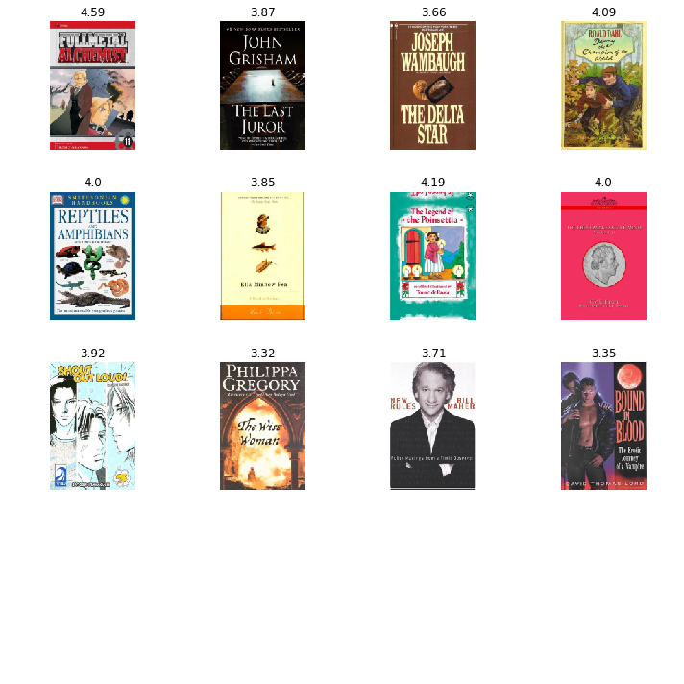
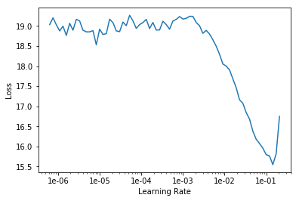
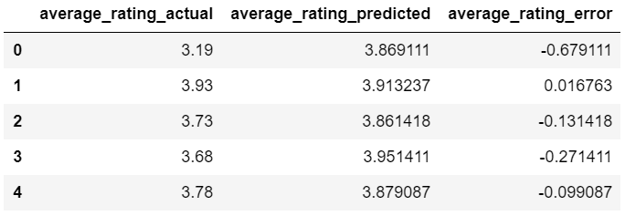
Modeling: Initial Training
For Each Target Variable:
Randomly split 20% of the samples for the validation set
Create mini-batches with 12 images of size 192x128 (determined via experimentation)
Create CNN based on the ResNet34 Architecture to start with a pre-trained model rather than from scratch
Identify a learning rate to ensure rapid convergence
Train for 5-8 epochs depending on whether the loss continued decreasing
Save validation set predictions to compare target variables

Slide 9
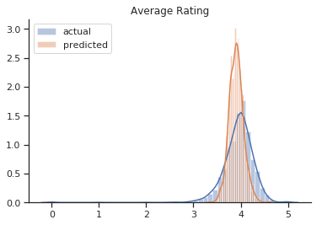
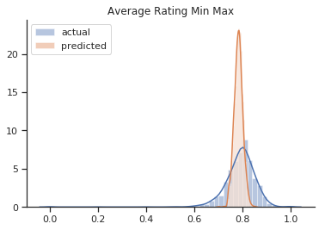
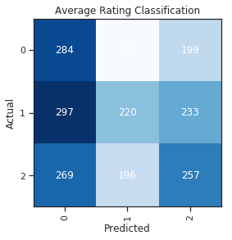
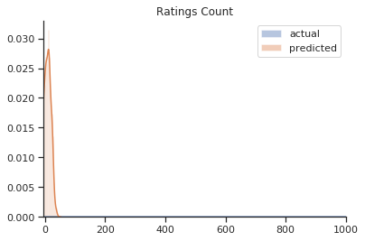
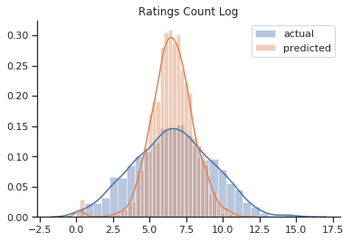
Modeling: Target Variable Selection
Rating Count Classification looks the least bad (42% accuracy); regression models center heavily around the mean
Regression: Raw Values
Regression: Transformed Values
Classification: High, Medium, & Low
Average Rating
Rating Count

Slide 10
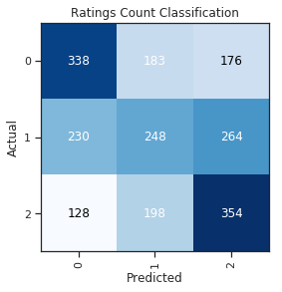
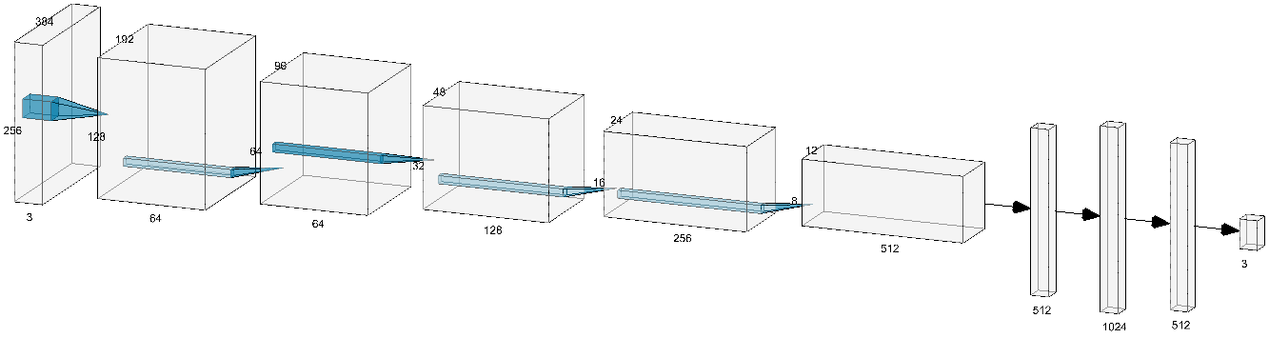
Modeling: Additional Training
Enhancing the Classification Model:
Unfreeze ResNet34 Layers & Train for 20 Epochs
Recreate Dataset with Larger Images
Refreeze & Train Last Layers for 3 Epochs
Final Architecture & Results:
44% Accuracy on the Validation Set
(Compared to 33% Baseline; P-Value < 0.0001)
40 trainable layers with 546,435 trainable parameters
ResNet34
(cut at the last convolutional layer)
Notes:
Model visualization: http://alexlenail.me/NN-SVG/LeNet.html
Multinomial hypothesis test: Chi-Squared Statistic = 105
ResNet34 cut at the last convolutional layer + an AdaptiveConcatPool2d layer, a Flatten layer, and 2 blocks of [nn.BatchNorm1d, nn.Dropout, nn.Linear, nn.ReLU] layers.

Slide 11

Deployment
www.book-cover-judger.com

Slide 12
Lessons Learned & Next Steps
LESSONS LEARNED
NEXT STEPS
1
Programming in Python
1
Determine Most Important Features
My previous programming experience mainly consisted of DataCamp exercises, so a full project in Jupyter was a constant learning experience
Extract and visualize the feature maps of each CNN block
Translate activations into importance
2
Deep Learning
2
Generate Book Covers with a GAN
The Neural Net lecture during the Bootcamp flew way over my head, so I really enjoyed having extra time to learn about CNNs, transfer learning, and other details
Collect more book covers & subset high popularity ones
Train GAN on subset
3
Importance of Experimentation
3
Build in PyTorch from Scratch
Looking back, I used the recommended hyperparameters and architecture structures too frequently. In future projects, I plan to experiment with different combinations so I can see what works best for my specific use case
Leverage complex architectures (e.g. ResNet101) & customize
Transition to an ordinal multi-label problem

Slide 13

Thank you!

